Slide 1
Tutorial – 4 (Business Cover Letter)

Slide 2
How do you explain experience in a cover letter?
WHO YOU ARE?
WHAT TYPE OF JOB/TASK YOU’RE LOOKING FOR?
WHY YOU ARE APPLYING FOR THIS POSITION?
YOUR FUTURE CAREER GOALS
YOUR RELEVANT SKILLS AND EDUCATION
YOUR PREVIOUS WORK EXPERIENCE, IF APPLICABLE
WHY YOU ARE A GOOD CANDIDATE FOR A ROLE

Slide 3
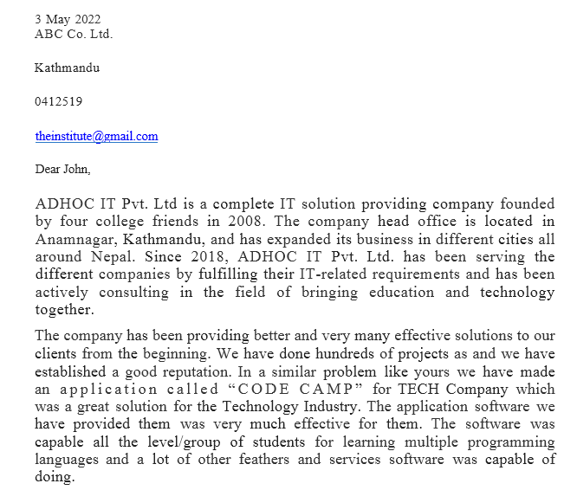

Slide 4
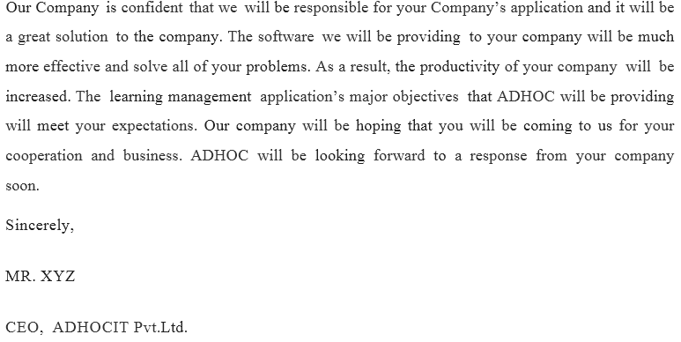

Slide 5
EXECUTIVE SUMMARY
summarize the key points of the report
It should restate the purpose of the report, highlight the major points of the report, and describe any results, conclusions, or recommendations from the report.
The name, location, and mission of your company.
A description of your company, including management, advisors, and brief history. Your product or service, where your product fits in the market, and how your product differs from competitors in the industry.

Slide 6
The proposal is made to the “ABC Company” for the development of the ________ Project. The application requires a lot of time and effort for initiation and the fulfillment of the objectives and target of the task. The proposal depicts the short briefing of our Company with its past working experience and qualification of each employees of the organization………………………….

Slide 7
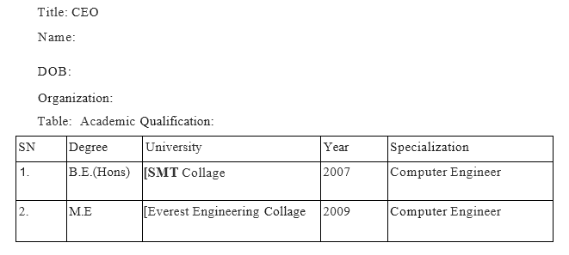
Qualification

Slide 8
LETTER OF REFERENCES

Slide 9
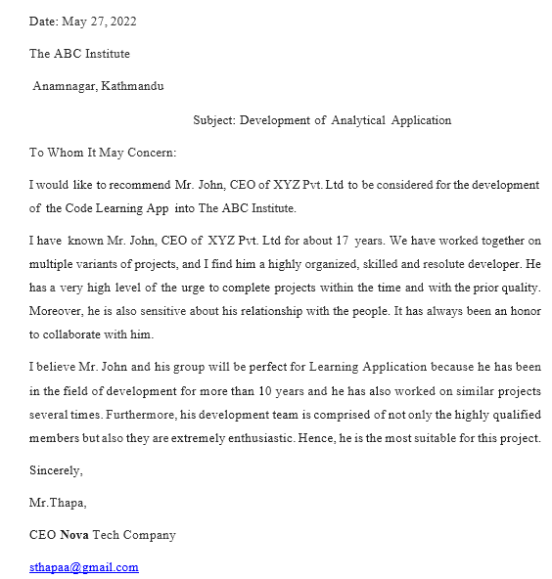

Slide 10
INDIVIDUAL COMPONENT
Presentation skills
INDIVIDUAL WORK:
Name:
I am much honored and it's my pleasure to have an opportunity to showcase my ability of mine for this project and for getting a chance to gain knowledge from my friends as well as the working environment. I am eternally grateful to our Asian Pacific University and Lord Buddha Education Foundation Campus (LBEF) for making me capable enough for doing such a crucial and enormous project. I am thankful to all the faculties' members of the LBEF Campus for helping me to find my feet and making me confident enough to take such a huge responsibility on my shoulder. This project has helped me to fully use my abilities and refined my skills even more. With every day on this project, I have learned a lot about the working environment and got a valuable chance to improve my skills.

Slide 11
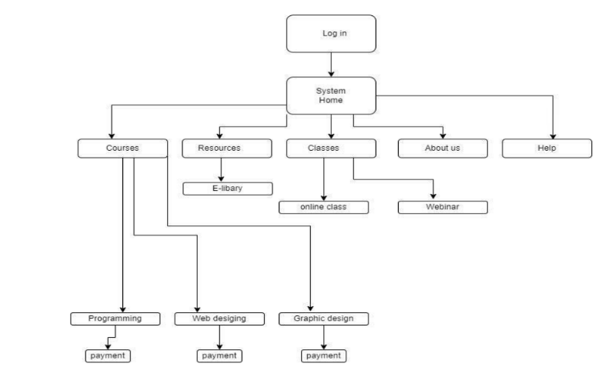
Planning (layout)

Slide 12
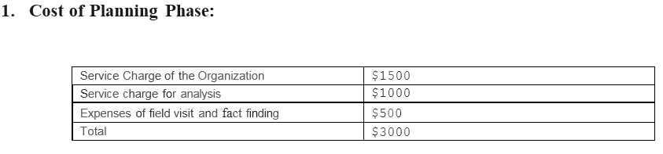
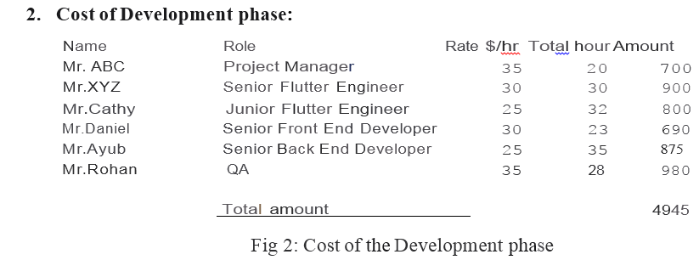
Cost Estimation

